Slide 1

ENES 104 Full-360 Group 2
Members: Antranig Tatarian, Joshua Fawole, Natneal Belete

Slide 2
Main Takeaways
Professionalism
Problem-solving
Team Collaboration
Perseverance in industry
Pursuit of knowledge

Slide 3
Perspective and lessons learned
Antranig
Root problems – Dr. Daniel Juliano
Being able to find root issues
Working with a team and problem-solving
Professionalism – Dr. Joseph Varghese
Favorite speaker, learned a lot about the perspective of someone working in Silicon Valley.
Interview the interviewer
The idea of having things as “good enough” in industry standards
Idea of “Are you able to learn and grow, because everything you know is good for 30 days before you need to learn something new.”
Opportunities are everywhere; you need to be able to adapt
to make yourself available, useful, and worth having
Perseverance – Dr. Islam
Be ok with saying “I don’t know”
Reliability is key
Being able to be a “wild-card” within a startup or small companies
Embracing failure. Always an opportunity to learn. You only lose if you don’t learn
Pursuing knowledge – Dr. Faranak Nekoogar
Always make the most of what you have
Starting late is ok
Technological breakthroughs

Slide 4
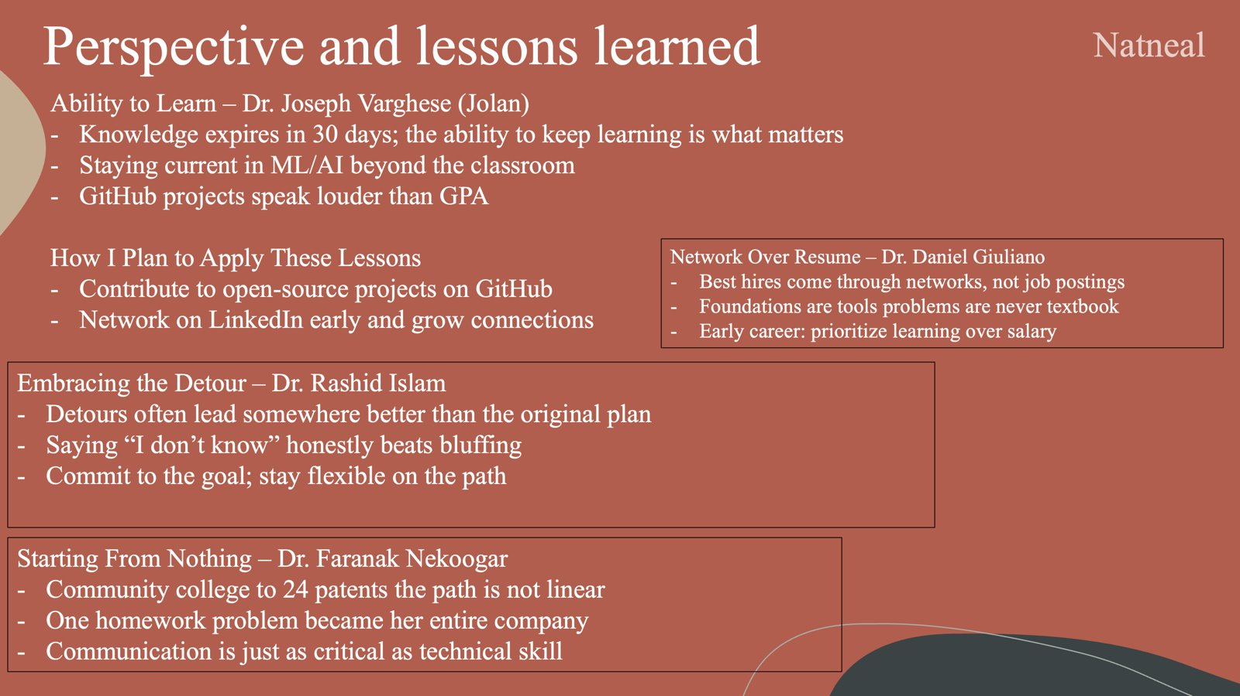
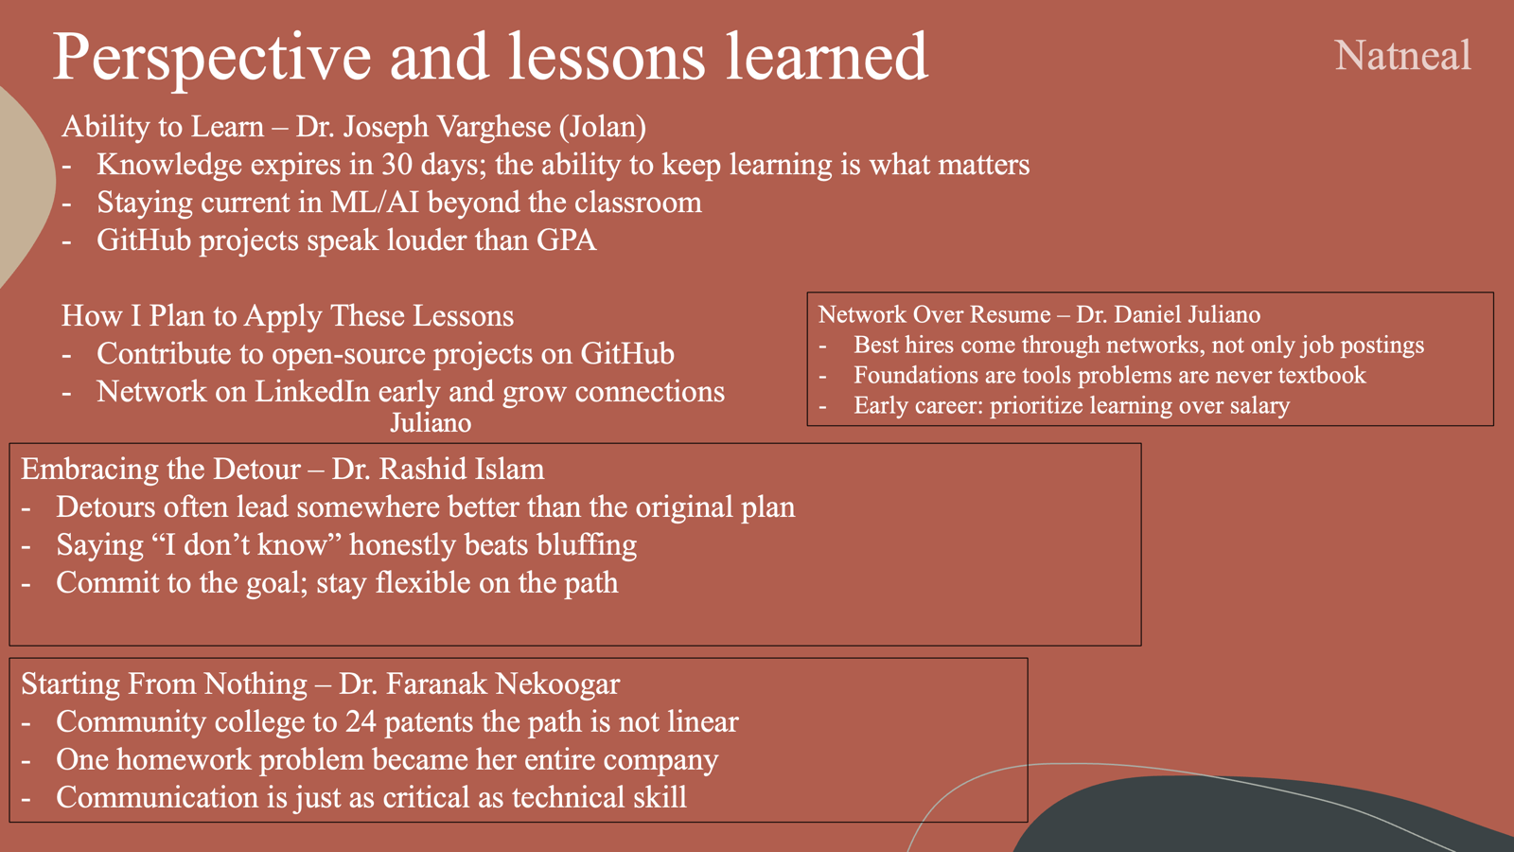

Slide 5
Perspective and Lessons Learned
Joshua
Emphasizing Impact – Dr. Joseph Varghese
Menial participation, or "bragging" about one's accomplishments in a resume will not impress a hiring manager, or make one's resume stand out
In every opportunity, ask yourself "how can I make an impact", chase that outcome, and then emphasize that impact in one's resume. (either numerical, personal, or occupational)
Maximize Every Opportunity – Dr. Daniel Juliano
Refrain from looking down upon early opportunities that do not yield immediate results or monetary value
One stands to gain more personal and occupational growth from a lesser position, than an immediate jump into a higher role
Embrace Knowledge from All Avenues – Dr. Rashid Islam
When it came to ensuring "reliability" for his Hovercraft project, Dr. Islam enlisted the insight of team members from many different industrial backgrounds.
Concerning any goal one is trying to achieve, the information on how to realize that goal can come from unexpected places, so stay open minded
Prioritize Developing Solutions to Practical Problems – Dr. Faranak Nekoogar
Dr. Faranak gave a powerful example of how listening to a firefighter fail to reach his team in a dire situation sparked the idea for an RFID solution
That solution then translated into a tag-reader system that is being utilized in shipping containters to provide a swift process of locating shipment
Ensure every solution one is trying to develop solves a practical problem, this is how your projects become "impactful"

Slide 6
CIP-1 What worked and what could be improved in ENES104
Enforce a structure of professionalism that’s expected during the first few sessions
Ex

Slide 7
CIP-2: How did you leverage the team-building workshop for this assignment? What feedback did you provide each other on this team assignment, and how? What could be further improved in your team’s work on this assignment?
This assignment requires little collaboration, other than the main takeaways
We all took what we thought was the most important thing we learned, and combined them.

